Slide 1
System Software
Course Code: 17ECSC302
Credits: 3
Semester: V
School of Computer Science & Engineering

Slide 2
Chapter 01
Introduction to a Machine Architecture

Slide 3
Introduction
Practical computer systems divide software into two major classes:
Application Software
System Software
System Software:
System software consists of a variety of programs that support
the operation of a computer .
To study “behind the scene”

Slide 4
Simplified Instructional Computer (SIC)
SIC is a hypothetical computer that includes the hardware features most often found on real machines
Two versions of SIC
standard model
extension version (XE version)

Slide 5
SIC Machine Architecture
Features
Memory
Register
Data Format
Instruction Format
Addressing Mode
Input/output
Instruction Set

Slide 6
SIC Machine Architecture
Memory
8-bit bytes
3 consecutive bytes form a word (24 bits)
All addresses in SIC are byte addresses
2¹⁵ bytes =32768 bytes in the computer memory

Slide 7
SIC Machine Architecture
Registers
There are 5 registers all of 24 bits in length

Slide 8
SIC Machine Architecture
Data Formats
Integers are stored as 24-bit binary numbers
2’s complement representation is used for negative values
8 bit ASCII code for characters
No floating-point hardware

Slide 9
SIC Machine Architecture
Instruction Formats
All instructions are of 24 bit format
Addressing Modes
opcode (8)
x
address (15)

Slide 10
SIC Machine Architecture
Instruction Set
Data transfer group
Arithmetic group
Logical group
Branch group
Machine group

Slide 11
SIC Machine Architecture
Data transfer Instructions
LDA-load data into accumulator
LDX- load data into index register
LDL-load data into linkage register
LDCH-load char into accumulator
STA-store the contents of A into the memory
STX-store the contents of X into the memory
STL-store the contents of L into the memory
STSW-store the contents of SW into the memory

Slide 12
SIC Machine Architecture
Arithmetic group of Instructions
ADD
SUB
MUL
DIV
All arithmetic operations involve register A and a word in memory, with the result being left in the register

Slide 13
SIC Machine Architecture
Logical group of Instructions
AND
OR
Both involve register A and a word in memory, with the result being left in the register. Condition flag is not affected.
COMP
Compares the value in register A(<,>,=) with a word in memory, this instruction sets a condition code CC to indicate the result.

Slide 14
SIC Machine Architecture
Branch group of Instructions
Conditional jump instructions
Unconditional jump instructions
Subroutine linkage

Slide 15
SIC Machine Architecture
Instruction Set
Conditional jump instructions:
JLT
JEQ
JGT
these instructions test the setting of CC (<.=.>)and jump accordingly.

Slide 16
SIC Machine Architecture
Instruction Set
Unconditional jump instructions:
J
This instruction without testing the setting of CC , jumps directly to assigned memory.

Slide 17
SIC Machine Architecture
Subroutine linkage:
JSUB
JSUB jumps to the subroutine, placing the return address in register L
( L 🡨 PC , PC 🡨 subroutine address)
RSUB
RSUB returns by jumping to the address contained in register L
( PC 🡨 L )

Slide 18
SIC Machine Architecture
Input and Output
Input and output are performed by transferring 1 byte at a time to or from the rightmost 8 bits of register A.
Test Device TD instruction tests whether the addressed device is ready to send or receive a byte of data.
if CC=‘<‘ the device is ready to send or receive.
if CC=‘=‘ the device is not ready to send or receive.

Slide 19
SIC Machine Architecture
Input and Output
Read Data RD
Data from the input device specified by the memory is read into A lower order byte.
Write Data WD
Data is sent to output device specified by the memory.

Slide 20
SIC Machine Architecture
Input and Output
TIX
Increments the content of X and compares its content with memory
Depending on the result the conditional flags are updated
if (X) < (m) then CC = ‘<‘
if (X) = (m) then CC = ‘=‘
if (X) > (m) then CC = ‘>‘

Slide 21
SIC/XE Machine Architecture
Memory
Memory structure is same as that for SIC.
2²⁰ bytes in the computer memory.
This increase leads to a change in instruction format and addressing modes.

Slide 22
SIC/XE Machine Architecture
More Registers

Slide 23
SIC/XE Machine Architecture
Data Formats
Same data format as that of SIC
Floating-point data type of 48 bits
frac: 0~1
exp: 0~2047
S(0=+ve , 1=-ve)
The absolute value of the number is frac*2^{(exp-1024)}
s
exponent (11)
fraction (36)

Slide 24
SIC/XE Machine Architecture
Instruction Formats
The instruction format of SIC/XE is modified to suit the changes made in the hardware such as:
Enhancing the number of address lines
Increasing the number of registers
Providing floating point accumulator

Slide 25
SIC/XE Machine Architecture
Instruction Formats
Formats 1 and 2 are instructions that do not reference memory at all
8
op
Format 1 (1 byte)
Format 2 (2 bytes)
8 | 4 | 4
op | r1 | r2
6 | 1 | 1 | 1 | 1 | 1 | 1 | 12
op | n | i | x | b | p | e | displacement
Format 3 (3 bytes)
6 | 1 | 1 | 1 | 1 | 1 | 1 | 20
op | n | i | x | b | p | e | address
Format 4 (4 bytes)

Slide 26
SIC/XE Machine Architecture
The Format 3 and Format 4 instructions have 6 flag bits:-
n – indirect addressing
I – immediate addressing
x – indexed addressing
b – base relative
p – PC relative
e – (0 – Format 3 1 – Format 4)

Slide 27
SIC/XE Machine Architecture
Addressing modes
Base relative (n=1, i=1, b=1, p=0)
Program-counter relative (n=1, i=1, b=0, p=1)
Direct (n=1, i=1, b=0, p=0)
Immediate (n=0, i=1, x=0)
Indirect (n=1, i=0, x=0)
Indexing (both n & i = 0 or 1, x=1)
Extended (e=1)

Slide 28
SIC/XE Machine Architecture
Base Relative Addressing Mode (STCH BUF,X)
 | n | i | x | b | p | e
opcode | 1 | 1 |  | 1 | 0 |  | disp
n=1, i=1, b=1, p=0, TA=(B)+disp (0≤disp ≤4095)
PC Relative Addressing Mode (J Next)(-ve=2’s comp
 | n | i | x | b | p | e
opcode | 1 | 1 |  | 0 | 1 |  | disp
n=1, i=1, b=0, p=1, TA=(PC)+disp (-2048≤disp ≤2047)

Slide 29
SIC/XE Machine Architecture
Direct Addressing Mode
 | n | i | x | b | p | e
opcode | 1 | 1 |  | 0 | 0 |  | disp
n=1, i=1, b=0, p=0, TA=disp (0≤disp ≤4095)
 | n | i | x | b | p | e
opcode | 1 | 1 | 1 | 0 | 0 |  | disp
n=1, i=1, b=0, p=0, TA=(X)+disp (with index addressing mode)

Slide 30
SIC/XE Machine Architecture
Immediate Addressing Mode (ADD #30)
 | n | i | x | b | p | e
opcode | 0 | 1 | 0 |  |  |  | disp
n=0, i=1, x=0, operand=disp
Indirect Addressing Mode (ADD @2000)
 | n | i | x | b | p | e
opcode | 1 | 0 | 0 |  |  |  | disp
n=1, i=0, x=0, TA=(disp)

Slide 31
SIC/XE Machine Architecture
Simple Addressing Mode (LDA NUM)
 | n | i | x | b | p | e
opcode | 0 | 0 |  |  |  |  | disp
i=0, n=0, TA=bpe+disp (SIC standard)
 | n | i | x | b | p | e
opcode | 1 | 1 |  |  |  |  | disp
i=1, n=1, TA=disp (SIC/XE standard)

Slide 32
SIC/XE Machine Architecture
Addressing Modes

Slide 33
SIC/XE Machine Architecture
Addressing Modes
Note: Indexing cannot be used with immediate or indirect addressing modes

Slide 34
Solve the following examples
i.LDA #3
GivenLDA=00H
ii.+JSUB RDREC
JSUB=4B
GIVEN RDREC =1036

Slide 35
Solve the following examples
STX LENGTH
Given EA=0033,[B]=0033
EA=[B]+DISP
STL RETADR
Given RETADR=0030 PC=0003
We know EA=[PC]+DISP

Slide 36
SIC/XE Machine Architecture
Data transfer Instructions
LDB(68)-load data into BASE register
LDS(6E)- load data into S register
LPS(D0)-load processor status
LDT(04)-load data into T register
LDF(70)-load data into F register
STB-store the contents of B into the memory
STS-store the contents of S into the memory
STL(14)-store the contents of L into the memory
STSW(E8)-store the contents of SW into the memory

Slide 37
SIC/XE Machine Architecture
Instruction Set
new registers: LDB,LDL,LDS, STB, etc.
floating-point arithmetic: ADDF, SUBF, MULF, DIVF
register move:data transfer from 1 reg to another reg RMO S,A (S🡪A)
register-register arithmetic: ADDR, SUBR, MULR, DIVR
Logical :
COMPR A,S
CLEAR X
SHIFTL T,n
SHIFTR T,n

Slide 38
SIC/XE Machine Architecture
Machine group of instructions
TIO
To test I/O channel.
HIO
To halt the I/O channel.
Channel address is provided in A register
SIO
To start the I/O channel.

Slide 39
Example of SIC/XE instructions and addressing modes

Slide 40
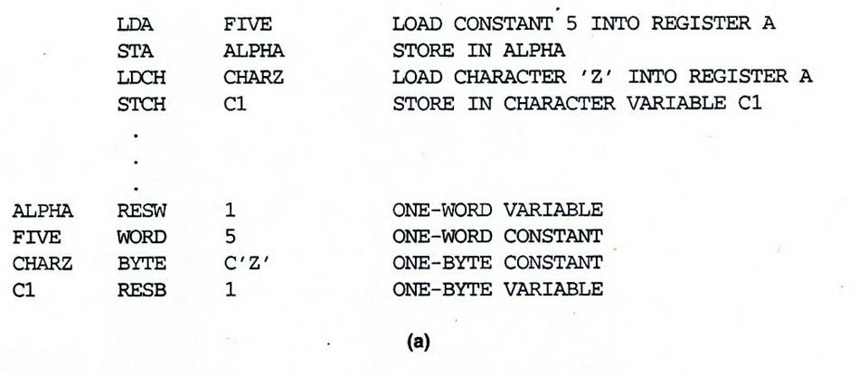
SIC Programming Examples (Fig 1.2a) To store 5 in ALPHA and z in C1

Slide 41
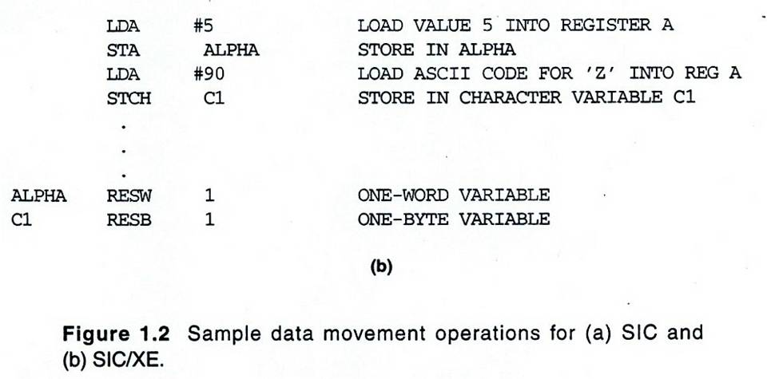
SIC/XE Programming Examples

Slide 42
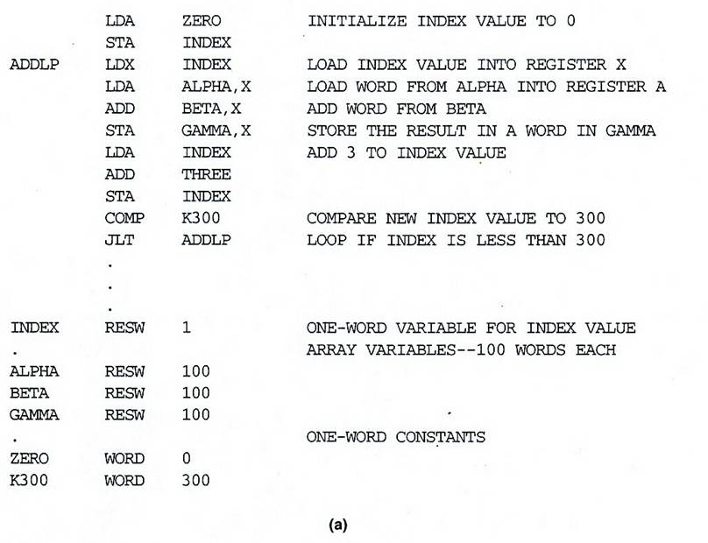
SIC Programming Example
GAMMA[I]=ALPHA[I]+BETA[I]
I=0 to 100

Slide 43
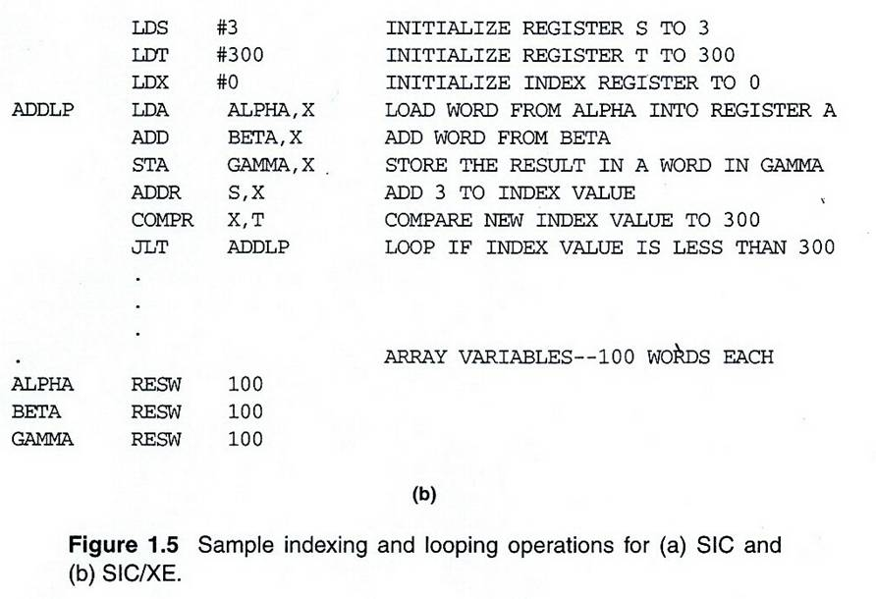
SIC/XE Programming Example

Slide 44
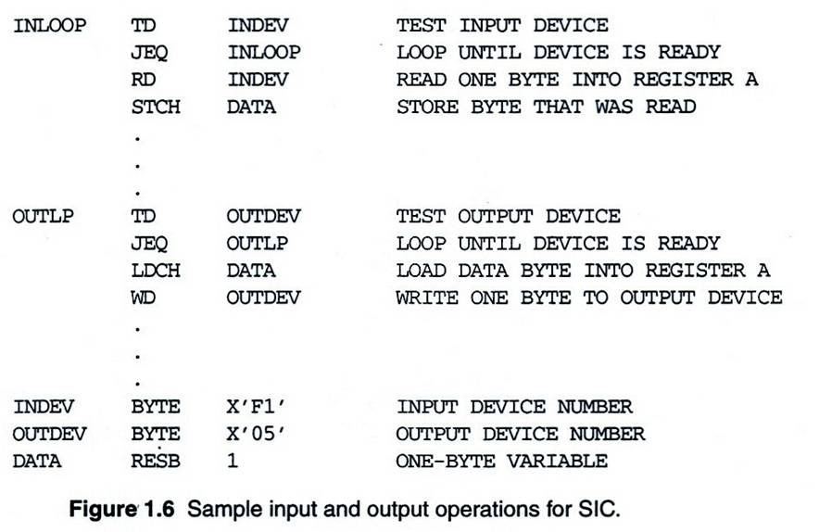
SIC Programming Example to read 1 byte of data from device F1 and copy it to device 05

Slide 45
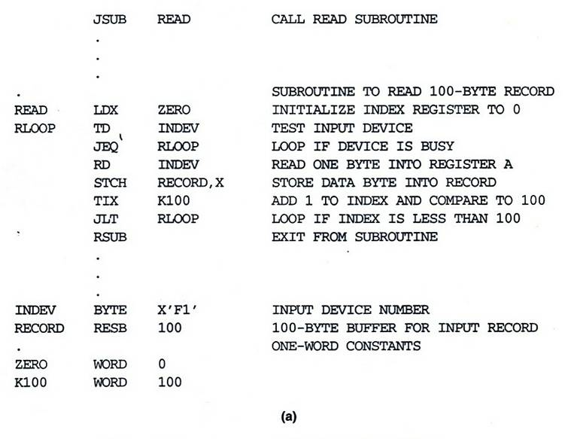
SIC Programming Example To read 100 bytes of record from an input device into memory

Slide 46
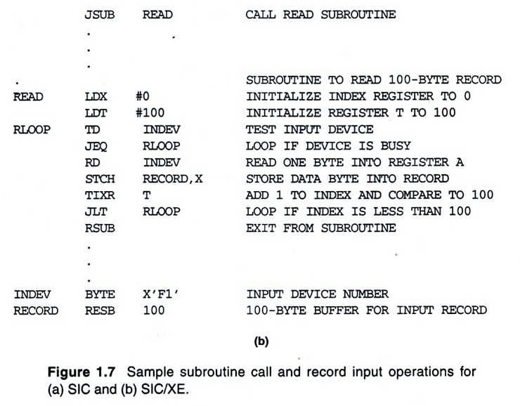
SIC/XE Programming Example

Slide 47
ANY QUESTIONS??

